Slide 1
Linear and logistic regression models
by manjot kaur

Slide 2
Intro:
What is ml?
Branch of AI
Develop algo and models that allow computers to learn and make predictions or decisions based on the data.
What is regression?
It is a method to find the relationship between variables and make predictions.
Lets talk on linear regression:
it is algo to solve supervised ml problems .

Slide 3
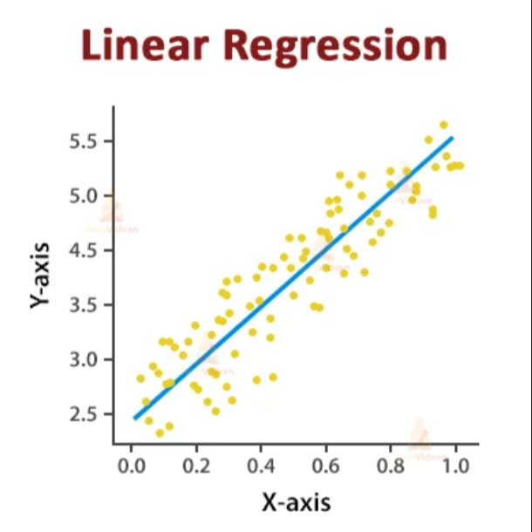
linear regression:.
Linear regression predicts the value of one variable based on the value(s) of another by fitting a straight line to the data.
Equation: y=mx+c

Slide 4
Step1:Reading and Understanding the Data
Imported the required libraries.
Load the data :
Using the pandas library to import and read data.
Example:
df = pd.read_csv('data.csv’)
Understanding the structure of the data.
Step2: Visualization of data
• Identify Continuous and Categorical Features
Visualizing Numeric Variables
Visualizing Categorical Variables
Step3: Cleaning of data :
Drop the unnecessary variables from the dataset
Check the datatypes

Slide 5
Step4:Data Preparation
Create dummy variables for categorical features.
Split the Data into Training and Testing Sets.
• Rescale the Features using Min-Max scaling
• Divide the data into X (features) and Y (target) sets for model building.
step5: Building a Linear Model
• Perform Recursive Feature Elimination to select important features.
Building model using statsmodel
• Calculate Variance Inflation Factor (VIF) to check for multicollinearity
. Step6: Making Predictions
Apply the scaling on the test sets.
• Divide the data into X_test and y_test.
• Use the trained model to make predictions on the test set.
• Calculate R-squared and Adjusted R-Squared for the Test set.

Slide 6
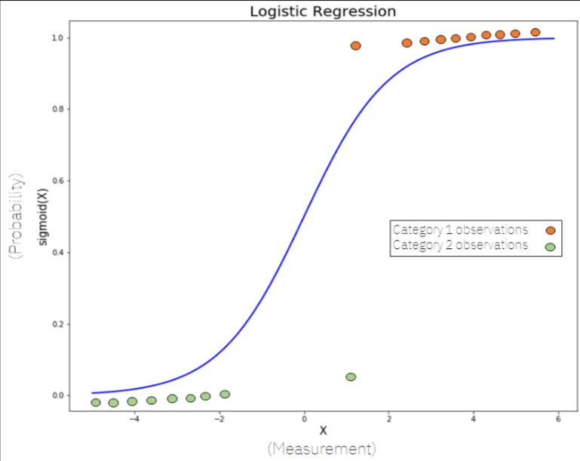
Step7:Model Evaluation
Visualize the fit on the test set.
• Plot actual vs predicted values.
• Calculate Mean Squared Error (MSE), and Root Mean Squared Error (RMSE).
What is Logistic Regression?
Logistic regression is used for binary classification where we use the sigmoid function, which takes input as independent variables and produces a probability value between 0 and 1.

Slide 7
Step1: Reading and Understanding the Data
Step2:. Data Visualization
Step3:Data Preparation
Step4:Building a Logistic Model
Step5:Model Evaluation:
• Evaluate the model using accuracy, recall,
• Plot the ROC( receiver operating characteristic ) curve to assess the model performance , it plot the true positive and false positive .
• Calculate the Area Under the Curve (AUC) score.
Step6:Recall
• Calculate recall to measure the model's ability to correctly identify positive instances.
• Calculate precision to measure the model's accuracy in identifying positive instances.

Slide 8
Thank you!!

